Slide 1
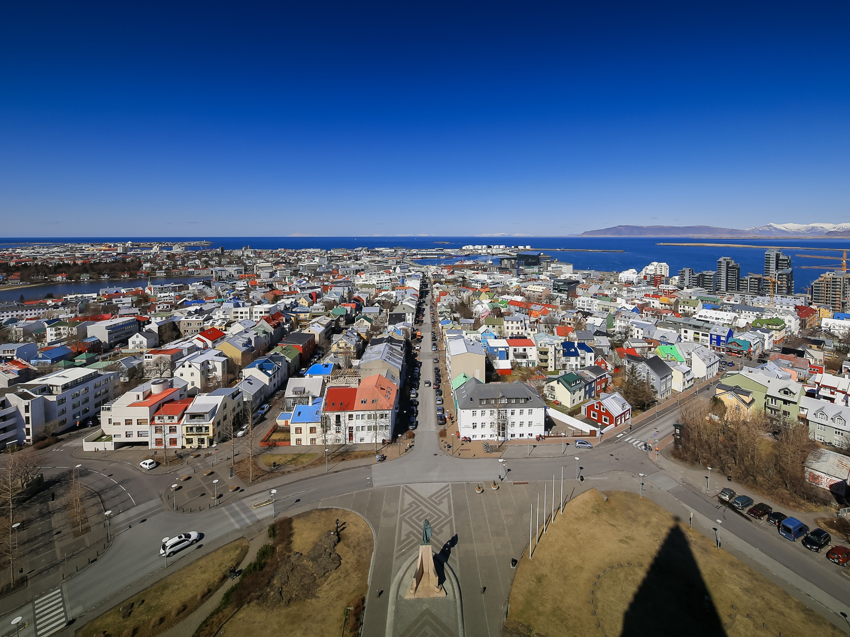
Reykjavik Housing Policy
Hrolfur Jonsson, director
Office of Property Management and Economic Development

Slide 2

Housing
One of our most complex and important policy issue
Health issue
Housing types
Economic factors
Social perspective
Environmental Effects
Planning and transportation
Multiple technical considerations
Governmental framework and regulation

Slide 3

2.700 apartments missing
On average construction has started on 660 apartments in Reykjavik per year
This dropped down to ten in 2010
The drop happens at a time when the population has been growing
The accumulated built up demand is for around 2.700 apartments

Slide 4

Tourism Creating More Pressure
Around 3,6 million guestnights sold in Reykjavik in 2016
Airbnb listings increasing fast – up to around 3,000 active listings
Tourists call for increase in labor pool – when unemployment is very low
Imported workers in tourism call for 300-500 additional apartments per year

Slide 6
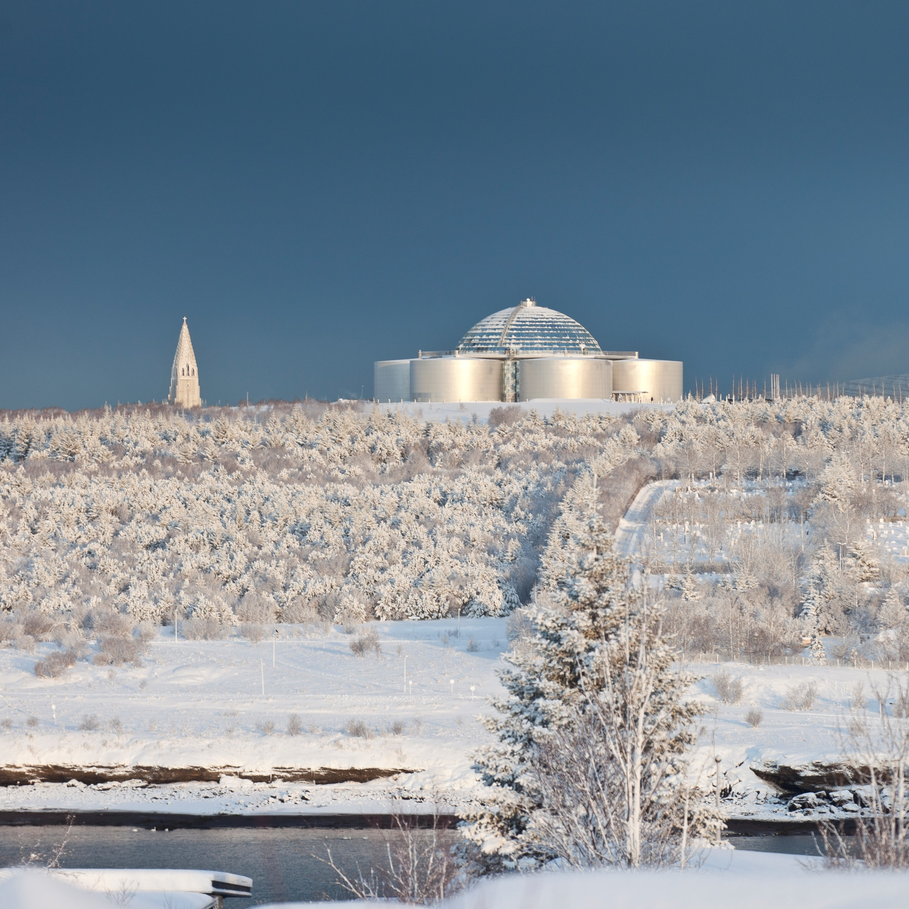
To own…
or to rent
or…
Own a part of our home…
and rent the other part
What is the best option?
Do we have any options?

Slide 7
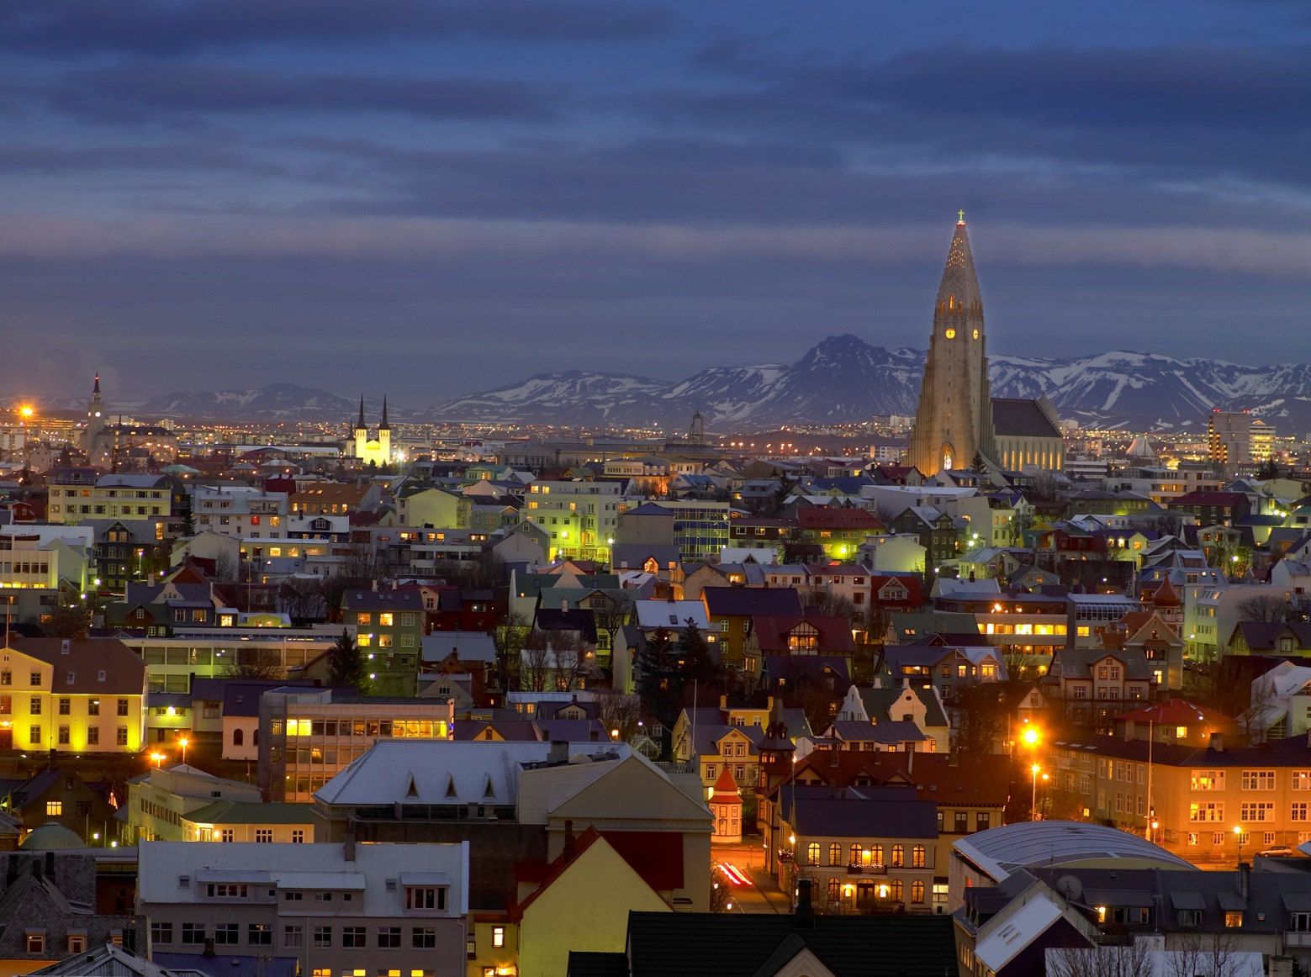

Key trends
Government and municipal policy
Home Mortgage interest decuction
Home Rental deductions
Tax environment of housing associations / municipalities
Urban planning, availability of lots
Access to financing and home loan to property value ratio
Inflation
Inflation index or non indexed loans
Rent

Slide 8

External influences
Economic cycles have a strong influence on home ownership
Other non economic cycles can also factor in (i.e. health issues, unexpected unemployment)
Risk related to home ownership unless home revenues can absorbe a sudden increase in payments
Should debt to home value exceed 60%?
Should income/revenue to debt/rent payments exceed 30% ?
Is there an established long term rental market?
Are we free to choose our path?

Slide 9

The answer is both yes and no
Some can choose (others cannot!)
Individual economic circumstances dictate whether we can buy or rent
A certain risk that those who owe much compared to income are badly exposed in hard times
The rental market as it funtions today can lead people into poverty traps

Slide 10
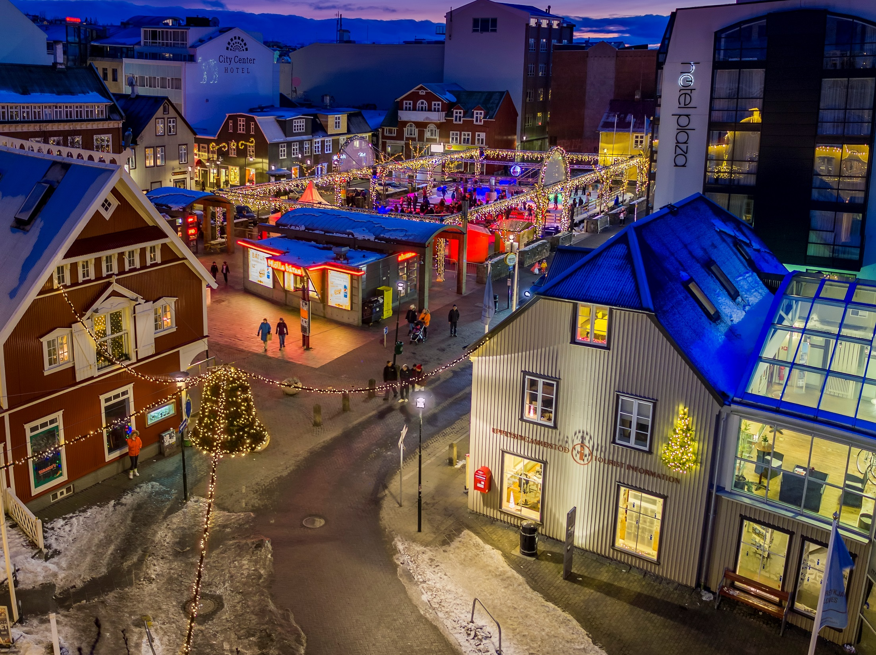
ERGO
It is highly desirable to establish a reliable, safe and fair rental market
Political ideologies?
Philosophical considerations?

Slide 11

City of Reykjavik Housing Policy
Estimating demand? Students, elderly, low income
Planning for ideal plots for buildings
Rules of appropriation and procedure
Appropriation of building lots, appropriation of apartments, aftermarket with lots and apartments
Market situation and EFTA Surveillance authority
Governmental incentives and grants

Slide 12
Reykjavik Housing Policy
Hrolfur Jonsson, director
Office of Property Management and Economic Development

Slide 13

The 100 Year Rent Model
100% Start Cost Split 60/40
60%
Funded with public bond issue
Bond repaid in 50 year with rental fees
40%
Funded by state (25%) and municipalities (15%)
Maintenance, government charges and fees and operating costs paid from the 100% start cost.
1,5% return on the public investment (state and muni)
paid by renters
Right to rent purchased when income rises above the maximum income level.
Rental fees og here after 50 years and costs are fully recovered in 50 years.
Minimum percentage of income
25 -30%

